Slide 1
Introduction to Git
Mugunthan L
Free Software Foundation TamilNadu

Slide 2

Version Control System
Collaboration
Versioning
Rolling Back
Understanding

Slide 3


Slide 4
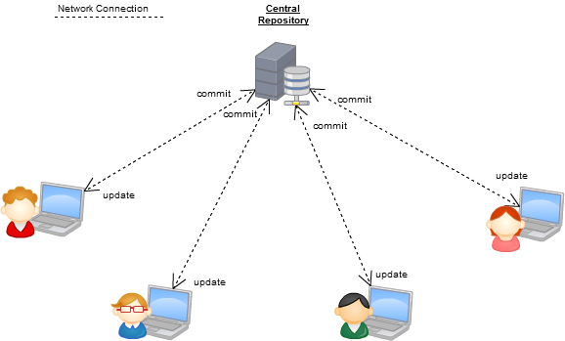
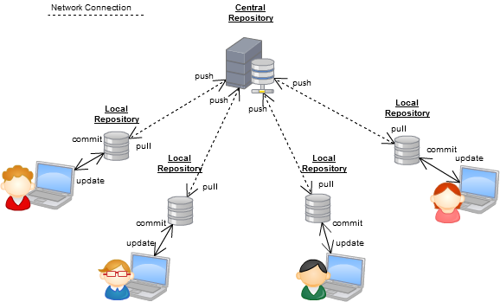
Version Control Systems
Git
CVS
Subversion
Mercurial

Slide 5
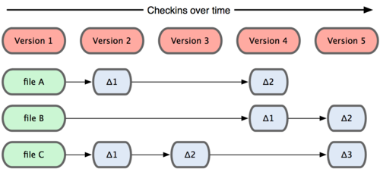
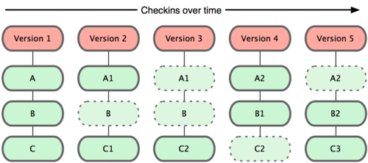
Why Git?
Subversion
Most used software for tracking changes in any set of files, usually used for coordinating work among programmers collaboratively developing source code during software development.
Git has many advantages over earlier systems such as CVS and Subversion
Git

Slide 6
Install Git
Via terminal
  sudo apt-get update
  sudo apt-get install git
Check the version
  git --version

Slide 7
Build Git from source on Linux
From your shell, install the necessary dependencies using apt-get:
  sudo apt-get update
  sudo apt-get install libcurl4-gnutls-dev libexpat1-dev gettext libz-dev libssl-dev asciidoc xmlto docbook2x
Clone the Git source (or if you don't yet have a version of Git installed, download and extract it)
  git clone https://git.kernel.org/pub/scm/git/git.git
To build Git and install it under /usr, run make:
  make all doc info prefix=/usr
  sudo make install install-doc install-html install-info install-man prefix=/usr

Slide 8
Introduce yourself to Git
Enter these lines (with appropriate changes):
git config user.name "John Smith"
git config user.email jsmith@gmu.edu

Slide 9
command | description
git clone url [dir] | copy a git repository so you can add to it
git add files | adds file contents to the staging area
git commit | records a snapshot of the staging area
git status | view the status of your files in the working directory and staging area
git diff | shows diff of what is staged and what is modified but unstaged
git help [command] | get help info about a particular command
git pull | fetch from a remote repo and try to merge into the current branch
git push | push your new branches and data to a remote repository
others: init, reset, branch, checkout, merge, log, tag
Git Command

Slide 10
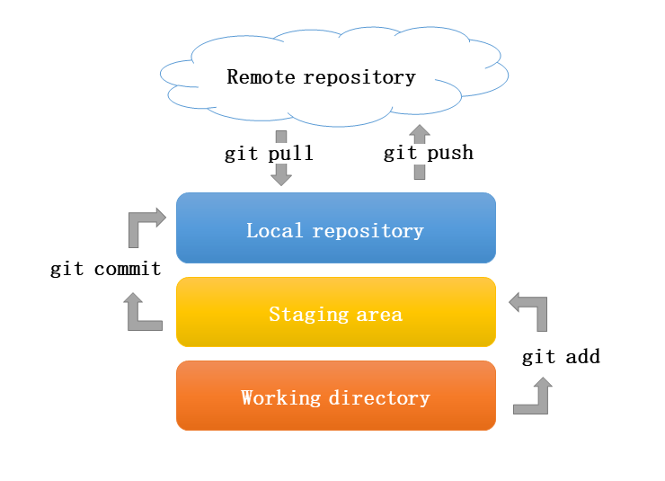

Slide 11
Thankyou

Slide 12
